Slide 1
Pushdown Automata

Slide 2
Pushdown Automata
Pushdown Automata is a finite automata with extra memory called stack which helps Pushdown automata to recognize Context Free Languages.

Slide 3
A Pushdown Automata (PDA) can be defined as :
Q is the set of states
∑is the set of input symbols
Γ is the set of pushdown symbols (which can be pushed and popped from stack)
q0 is the initial state
Z is the initial pushdown symbol (which is initially present in stack)
F is the set of final states
δ is a transition function which maps Q x {Σ ∪ ∈} x Γ into Q x Γ*. In a given state, PDA will read input symbol and stack symbol (top of the stack) and move to a new state and change the symbol of stack.

Slide 4
A Pushdown Automata (PDA)
Pushdown automata is a way to implement a CFG in the same way we design DFA for a regular grammar. A DFA can remember a finite amount of information, but a PDA can remember an infinite amount of information.
Pushdown automata is simply an NFA augmented with an "external stack memory". The addition of stack is used to provide a last-in-first-out memory management capability to Pushdown automata. Pushdown automata can store an unbounded amount of information on the stack. It can access a limited amount of information on the stack. A PDA can push an element onto the top of the stack and pop off an element from the top of the stack. To read an element into the stack, the top elements must be popped off and are lost.
A PDA is more powerful than FA. Any language which can be acceptable by FA can also be acceptable by PDA. PDA also accepts a class of language which even cannot be accepted by FA. Thus PDA is much more superior to FA.

Slide 5
PDA Components:
Input tape: The input tape is divided in many cells or symbols. The input head is read-only and may only move from left to right, one symbol at a time.
Finite control: The finite control has some pointer which points the current symbol which is to be read.
Stack: The stack is a structure in which we can push and remove the items from one end only. It has an infinite size. In PDA, the stack is used to store the items temporarily.

Slide 6
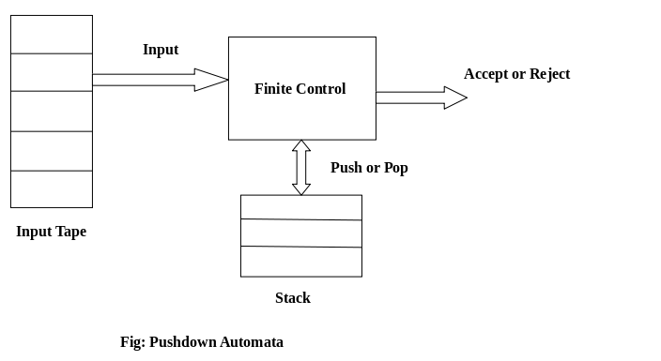

Slide 7
PDA Form:
Input Symbol, Popped-> Push on the Top

Slide 8
Example
L={ 0^n 1^n | n> 0 }

Slide 9
Pushdown automata | finite automata
For Type-2 grammar we can design pushdown automata. | For Type-3 grammar we can design finite automata.
Non – Deterministic pushdown automata has more powerful than Deterministic pushdown automata. | Non-Deterministic Finite Automata has same powers as in Deterministic Finite Automata.
Not every Non-Deterministic pushdown automata is transformed into its equivalent Deterministic pushdown Automata . | Every Non-Deterministic Finite Automata is transformed into an equivalent Deterministic Finite Automata
Context free languages can be recognized by pushdown automata. | Regular languages can be recognized by finite automata.
Pushdown automata has the additional stack for storing long sequence of alphabets. | Finite Automata doesn’t has any space to store input alphabets.
It gives acceptance of input alphabhets by going up to empty stack and final states. | It accepts the input alphabets by going up to final states.

Slide 10
Practice examples
L = {0^{n}1^{m}2^{m}3^{n} | n>=1, m>=1}

Slide 11
L = {0^{n}1^{m} | n>=1, m>=1}

Slide 12
L = {0^{n}2^{m}3^{n} | n>=1, m>=1}

